Slide 1

JavaScript jazyk, platformy, technológie
VAVJS - FIIT 2018 (cca 40min

Slide 2
Prečo JavaScript ?!
Prečo ste si vybrali JavaScript ?
Prečo som si ja “vybral” JavaScript ?
Prečo si ”svet” vybral JavaScript ?

Slide 3
1. Čo všetko sa dnes kóduje v JavaScripte
events, validations, HTML, CSS, user interaction
Browser
Mobile
apps
PhoneGap,
React Native,...
-> app logic
networking (AJAX apps)
XHR
Web Sockets
tools,
DevOps, ...
CLI
JSON, JSONSchema, JWS, JWE, data
Desktop UI
apps
nw.js,
electron,...
Web Server
WebServers, middleware, proxies,
app logic, integrations
tests, administration, maintenance
Cloud APIs
AI, CV, GEO,
R, Alexa...
JS Queries, map, reduce
Devices, IoT
JS microcontrollers,
XS6
no-sql, JSON documents as model
Database
FS
tests, administration, maintenance
Embeded
Duktape,JVM, Java, Nginx,
Graal VM

Slide 4
2. Komunita a kultúra
open-source
npm
git
testy
CI
linting, styleguides
security*

Slide 5
2. Komunita a kultúra - git
väčšina npm modulov (ale aj browser knižníc) je dostupná na github.com
github is your new google (reading code is the best way to learn)
máte k dispozícii zdrojáky
readme.md, wiki, docs
máte možnosť reportovať a komunikovať issues, klásť otázky
máte možnosť forknúť si a opraviť, vylepšiť modul a následne inštalovať z gitu
pull requesty – opravu môže autor prebrať do originál modulu

Slide 6
2. Komunita a kultúra - testy
K väčšine modulov sú k dispozícii testy
ľahšie robenie vylepšení (optimalizácie, refactoring)
ľahšie robenie zmien (nepokazil som svojou novou funkcionalitou niečo doteraz fungujúce)
menej dokumentácie, veľakrtát jenfunkcionalita definovaná a popísaná v testoch
testy sú súčasťou workflowu

Slide 7
3. Univerzálnosť jazyka
Je multiparadigm language, znamená že sa v ňom dá programovať
Objektovo
Funkcionálne
Streamovo
Imperatívne, Deklaratívne, …
Oproti iným jazykom a platformám
si nemusíte vybrať a prisôsobiť sa paradigm jazyka ale
v JS to môžete miešať a využívať tie ktoré sú kde vhodné
Jazyk rastie v malých iteráciách a je stale backward compatible

Slide 8
Prečo JavaScript
Nejaké názory od ostatných:
The World's Most Misunderstood Programming Language
R.Dahl 2018: Best Dynamic Language
Kyle Simpson: Keep Betting on JavaScript
Brendan Eich, Douglas Crockford,... JavaScript is Assembly Language for the Web
Lebo je to trendy a existujú ponuky práce:
chcete to vedieť používať
alebo tomu chcete rozumieť
...

Slide 9
History and Evolution
from browsers to server side and desktop runtimes

Slide 10
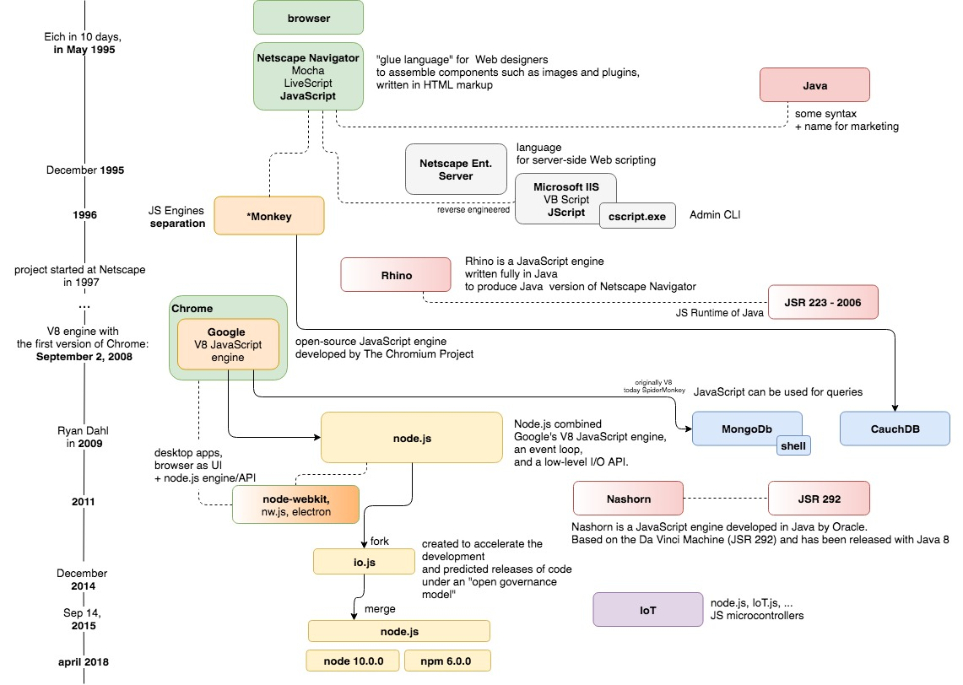
JavaScript - platforms
1995 – browsers
1996 – runtime extracted
2006 – Java + JavaScript
2008 – V8
2008 – node.js
2011 – Java + JavaScript
2014 – io.js
2011 – node + browser
201X – IoT
2018 - Ryan Dahl, 10 regrets
20XX - ????
Notes:
TODO: add R.D video from 2018 where he Regrets 10 things about node.js

Slide 11
What is and is not JavaScript
JavaScript and Related Technologies
How is browser JS related to server side JS
Most of code is not JavaScript it is just using some other APIs from JavaScript

Slide 12



JavaScript in browser and node.js
css
JS
JS
html
Events
Events
Web APIs
timers
Events
node.js APIs
timers
I/O
DOM, XHR,...
workers
I/O
FS, NET, ...
workers
browser infrastructure
node.js infrastructure

Slide 13
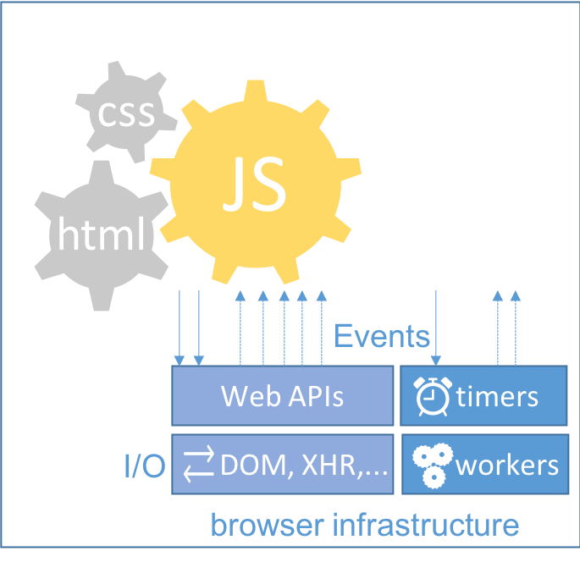
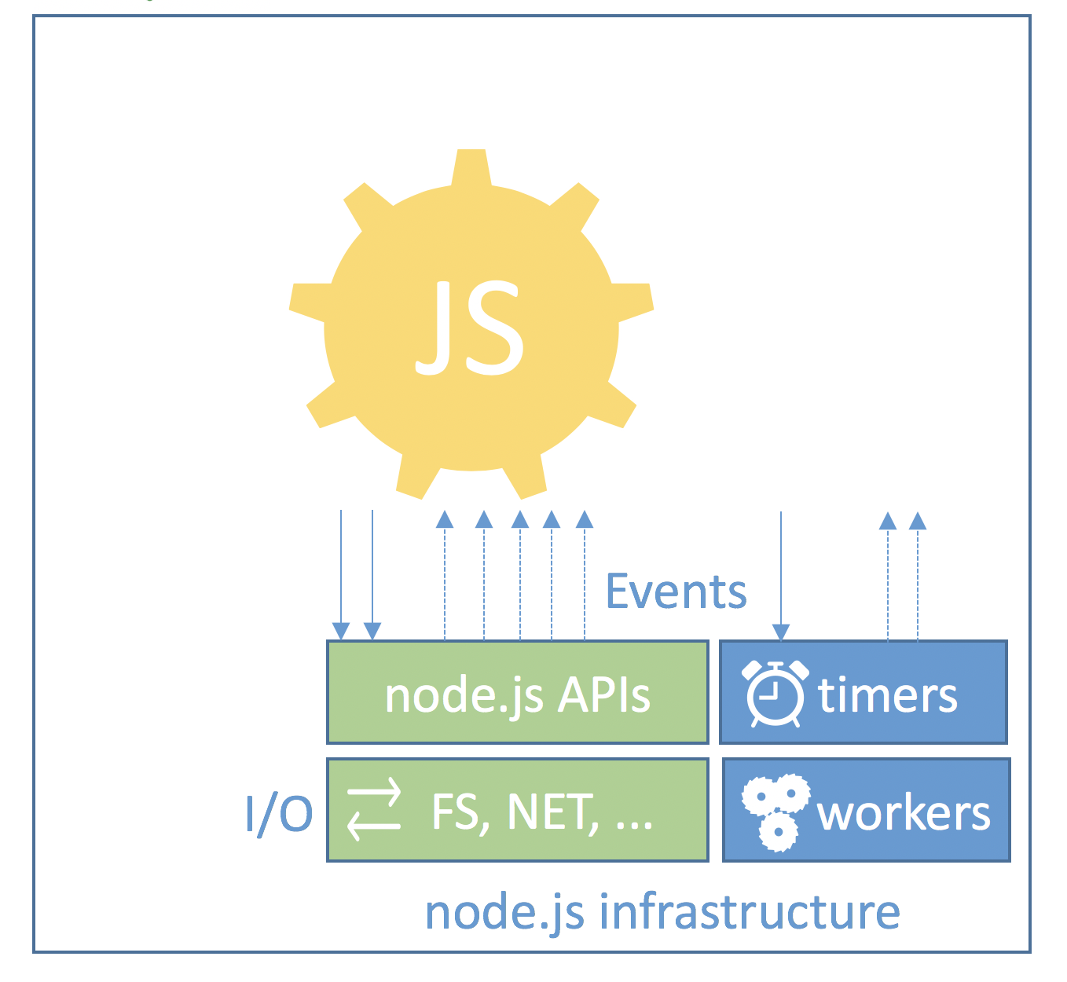
Language, APIs, Concepts, Techs, Libs,..
Functions
Objects
Classes
Promises
Generators
async
Data Types
Build In Objects
Statements
Operators
Grammar
angular
JSON, ...
tcp, udp
DOM, CSS
react
jQuery
dojo
XHR
events
async
http,https, url
request
express
BOM
streaming
....
meteor
stream
...
HTTP, WebSockets, URL
fs, path
JSON, JSONSchema, JWE, JWS,...
HTML, CSS
...
WebSockets
...
...
ws
...
FP
OOP
RP
...
...

Slide 14
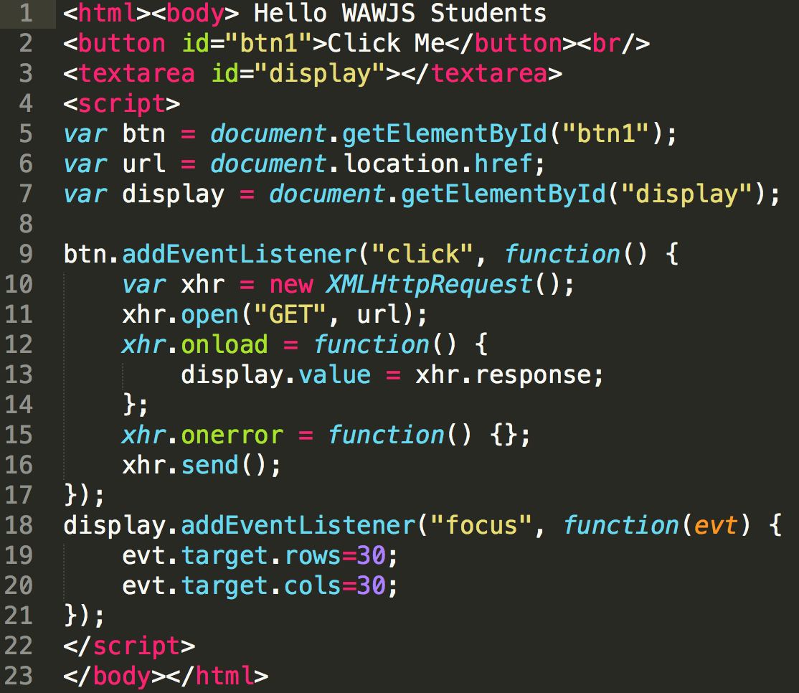
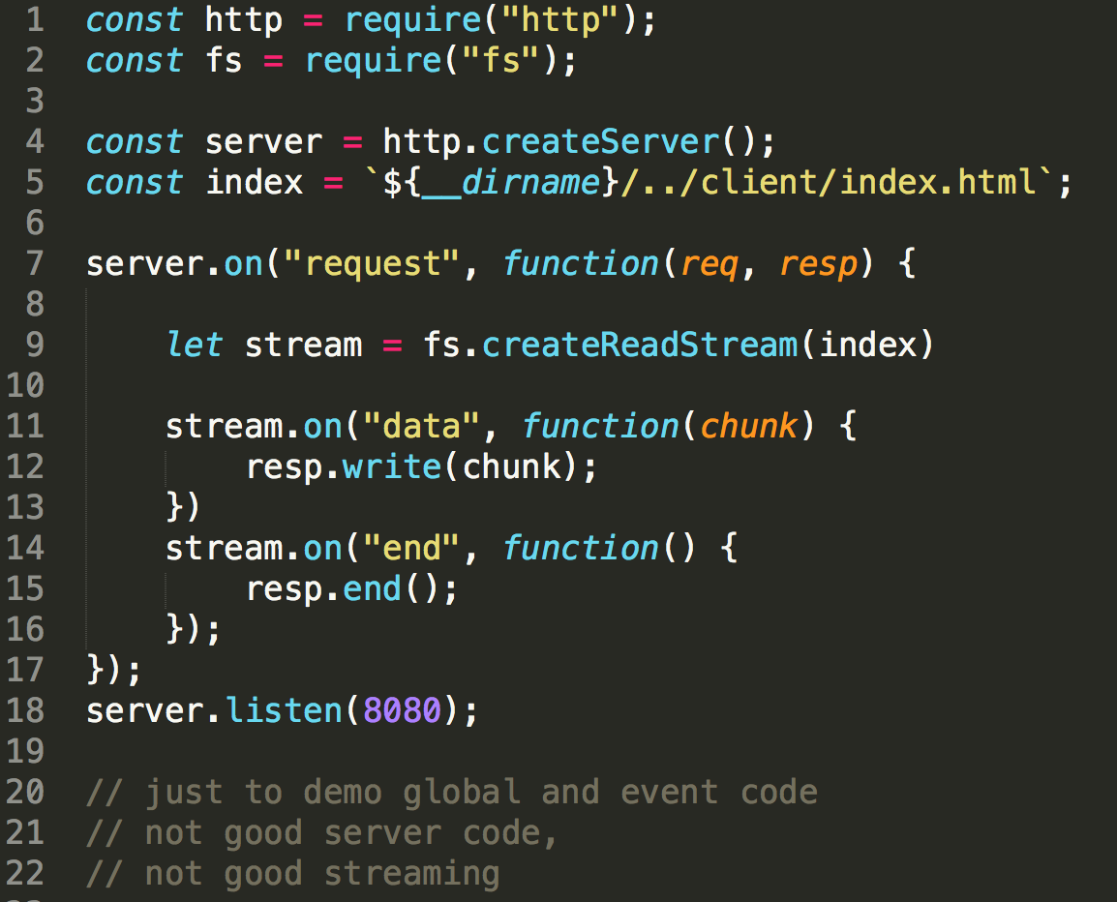

Events – Common Concepts
Events
Global code
Event handler Code
Event handler Code

Slide 15
What is and is not JavaScript – matrix
JavaScript language, technologies, libraries, APIs, patterns
Language:
…
…
Technologies:
…
…
Libraries:
…
…
Patterns:
…
…

Slide 16
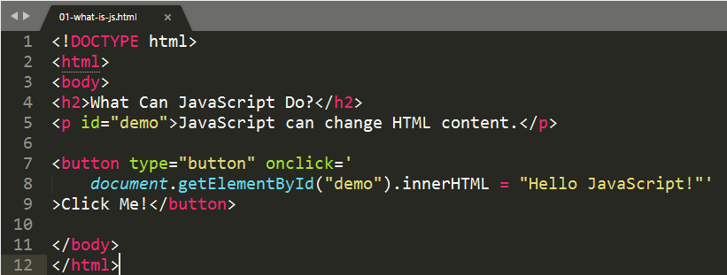
What is (not) JavaScript
(D)HTML,
HTML5 event handler content attribute
Web API
DOM
proprietary,
DOM Parsing and Serialization
from: https://www.w3schools.com/js/js_examples.asp

Slide 17
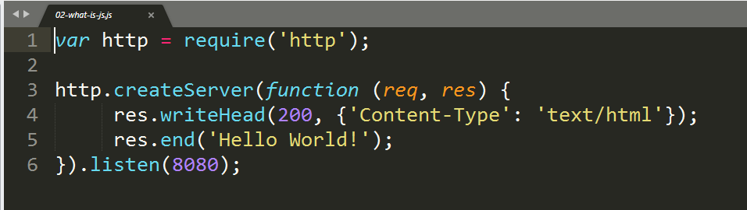
What is (not) JavaScript
Node modules
Common.js
JS + “callback pattern”
node.js API
http/mime
node.js API (http)
from https://www.w3schools.com/

Slide 18
Server Side JavaScript Engines
Server Side Engines – selected engines I have met

Slide 19
Standalone JavaScript Shells
Node.js - 2018,
Rhino, Nashorn – 2018, JavaScript for JVM, part of JDK, Java->JavaScript, JavaScript -> Java
GraalJS – 2018, A high performance implementation of the JavaScript programming language. Built on the GraalVM by Oracle Labs.
mongo (shell) – 2018, interactive JavaScript interface to MongoDB
xs6 – 2018, XS6 library implements a JavaScript virtual machine optimized for devices with limited resources. This virtual machine conforms to the 6th edition of the ECMAScript specification (ECMAScript 2015).
Duktape - 2018, an embeddable Javascript engine, with a focus on portability and compact footprint.
V8CGI – now TeaJs – 2012, A useful set of C++ and JS libraries, allowing the use of JS as a server-side (possibly HTTP processing) language. Basic functionality includes IO, GD, MySQL, Sockets, Templating, FastCGI and Apache module.
JSDB - 2012, JavaScript for databases, a scripting language for data-driven, network-centric programming on Windows, Mac, Linux, and SunOS. JSDB works with databases, XML, the web, and email
JavaLikeScript (JLS) - ??? A standalone, extensible JavaScript shell including both native and JavaScript libraries.
GLUEscript - 2012, A standalone JavaScript shell for writing cross-platform JavaScript applications. It can use wxWidgets for GUI apps and was formerly called wxJavaScript.
jspl - 2012, 2014 - A standalone JavaScript shell enhanced by Perl. Can use Perl modules directly from JavaScript: DBI for database integration, GTK2 for GUI apps, POSIX for system programming, etc. The best of CPAN now for JavaScript programmers.
https://developer.mozilla.org/en-US/docs/Web/JavaScript/Shells (quite bad list), https://en.wikipedia.org/wiki/List_of_ECMAScript_engines, use kangax compat table for notable runtimes

Slide 20



mongodb shell – mongo command
an interactive JavaScript interface to MongoDB
to perform administrative operations
to query and update data
Spider Monkey used as engine (previously V8 used)
ECMAScript 2015 (aka ES6) features, ES7,8, Next ?
Removed features
Sync
No module system (load)
Extra globals (db, ...)
mongo command - to run scripts, eval or interactive REPL
https://docs.mongodb.com/manual/mongo/ ; https://docs.mongodb.com/manual/release-notes/3.2-javascript/;

Slide 21

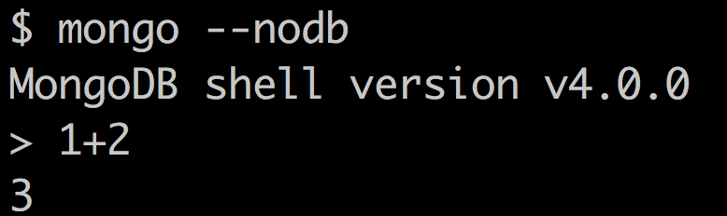
mongo shell
REPL – interactive
--nodb – when you want to use it without db
Autocomplete
Print
Save load scripts
...

Slide 22
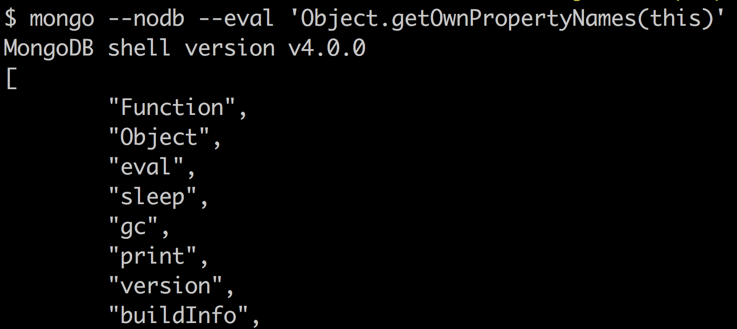
mongo shell
--eval – evaluate string from cmd line
Own runtime globals
print
...
...

Slide 23
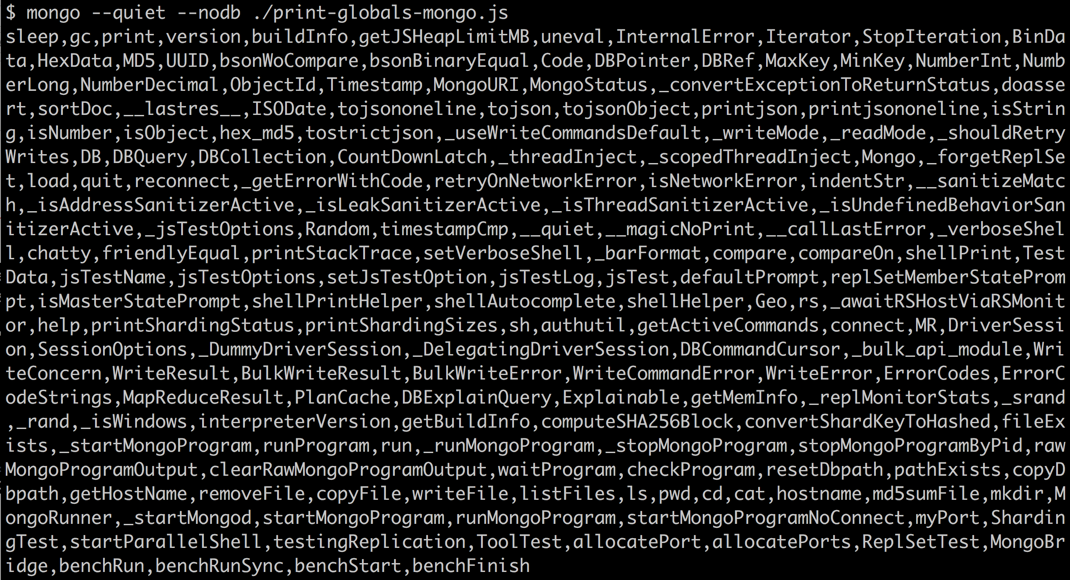
mongo shell
Execute *.js files
Sample output of extra globals compared to node.js

Slide 24
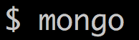
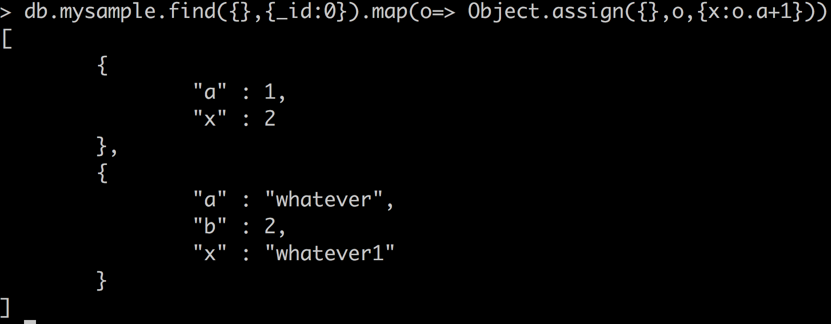
mongo shell – Interact with database
to query and update data
Combine DB Queries with JavaScript constructions
Perform administrative operations

Slide 25
Nashorn - JavaScript for the JVM
https://moduscreate.com/blog/javascript-and-the-jvm/
„JavaScript for the JVM“
Nashorn is a JavaScript engine developed in the Java programming language by Oracle.
It is based on the Da Vinci Machine (JSR 292) and has been released with Java 8.
Allow embedding JavaScript in Java applications via JSR-223 and
Develop standalone JavaScript applications
OpenSource http://openjdk.java.net/projects/nashorn/
JEP 335: Deprecate the Nashorn JavaScript Engine
Implementation of the ECMAScript Edition 5.1 Language Specification (2009)
Access to Java API, extra globals
No module system (load)
jjs command - to run scripts or interactive REPL, or Shell invocations
https://docs.oracle.com/javase/8/docs/technotes/guides/scripting/nashorn/intro.html

Slide 26
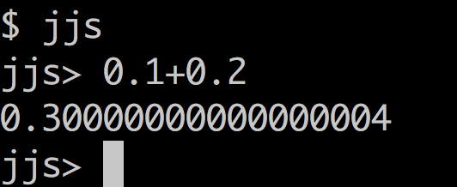
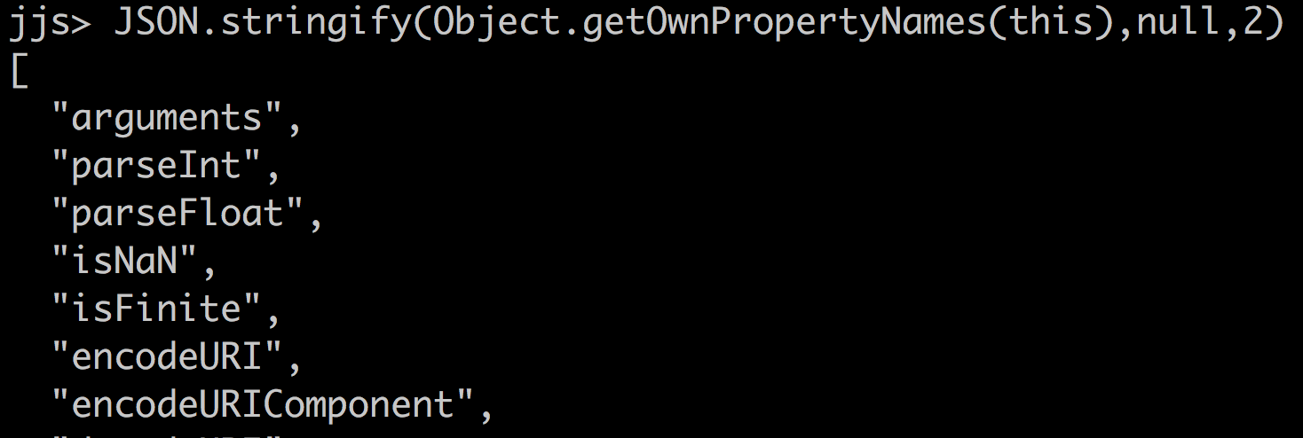
Nashorn – jjs
REPL – interactive
No autocomplete ?
No previous next command ?
Own globals
https://docs.oracle.com/javase/8/docs/technotes/guides/scripting/nashorn/intro.html , https://docs.oracle.com/javase/8/docs/technotes/tools/unix/jjs.html

Slide 27
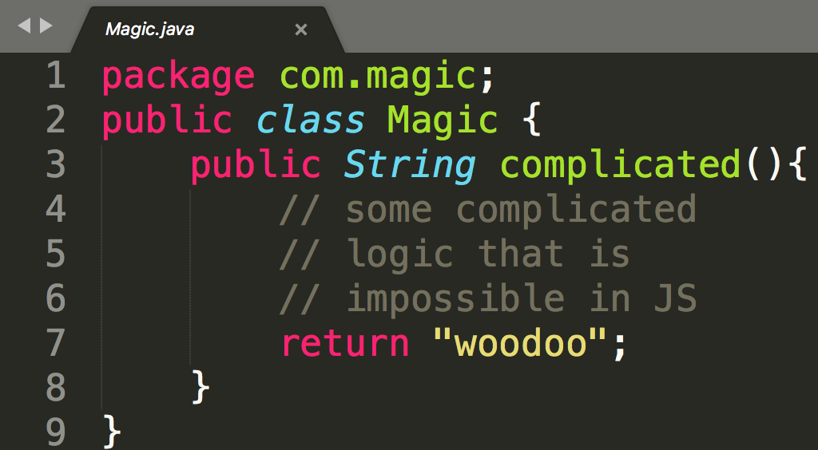
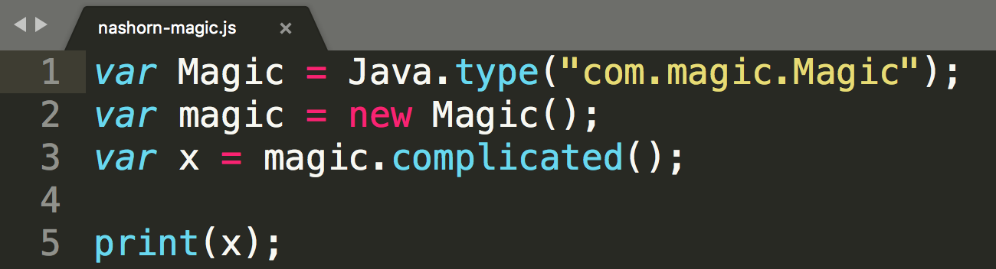
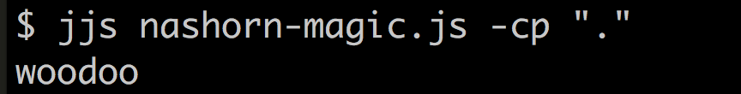
Nashorn – jjs – access to Java
Use Java from JavaScript
Margshaling unmarshaling types
Returning Objects
Thread safety
Extending classes
https://docs.oracle.com/javase/8/docs/technotes/guides/scripting/nashorn/api.html#sthref18

Slide 28
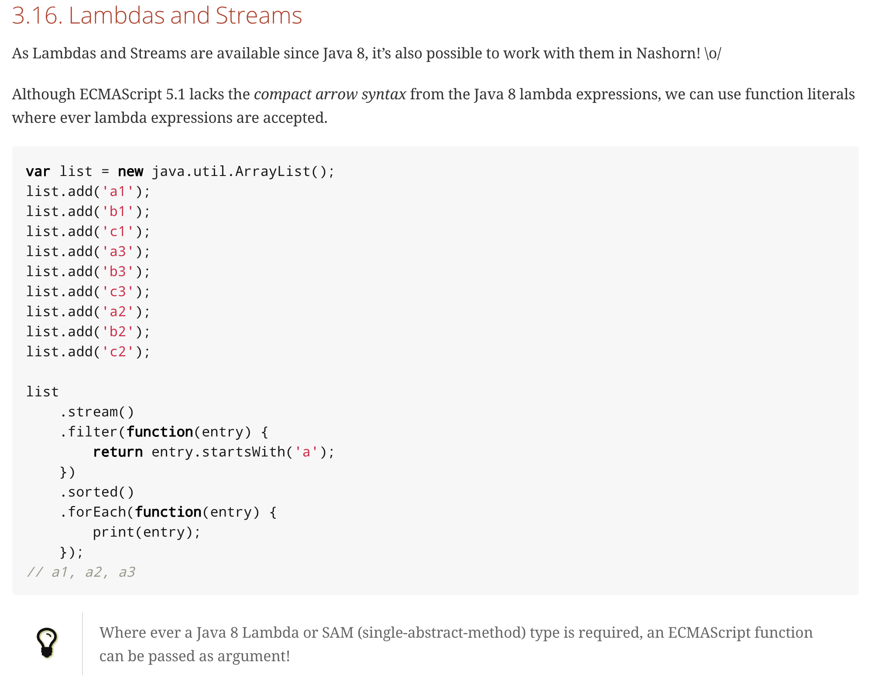
Nashorn – jjs – access to Java
More practical examples
Some people use JavaFX from JS
...
...
https://www.n-k.de/riding-the-nashorn/

Slide 29
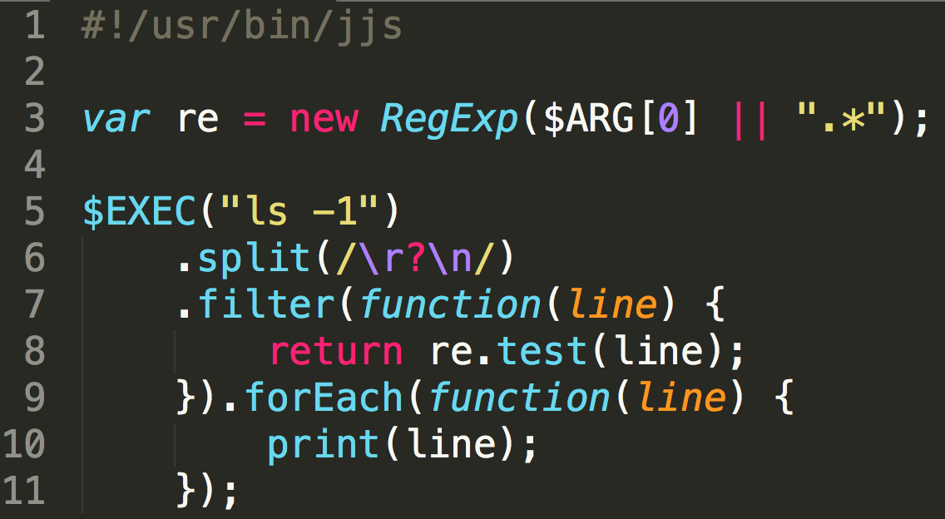
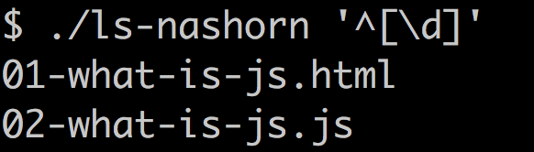
Nashorn – jjs – Nashorn and Shell Scripting
Nashorn implements a number of its own syntax and API extensions
jjs –scripting
Access to shell
To build new bash commands in JS+Java+Shell
https://docs.oracle.com/javase/8/docs/technotes/guides/scripting/nashorn/shell.html

Slide 30
cscript.exe – ms windows scripting engine
before PowerShell we had
VBScript
JScript
WSH
Integration with COM technology, access to system and other functionality
very old JS version, with all MS JScript deviations

Slide 31
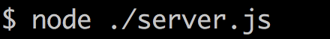
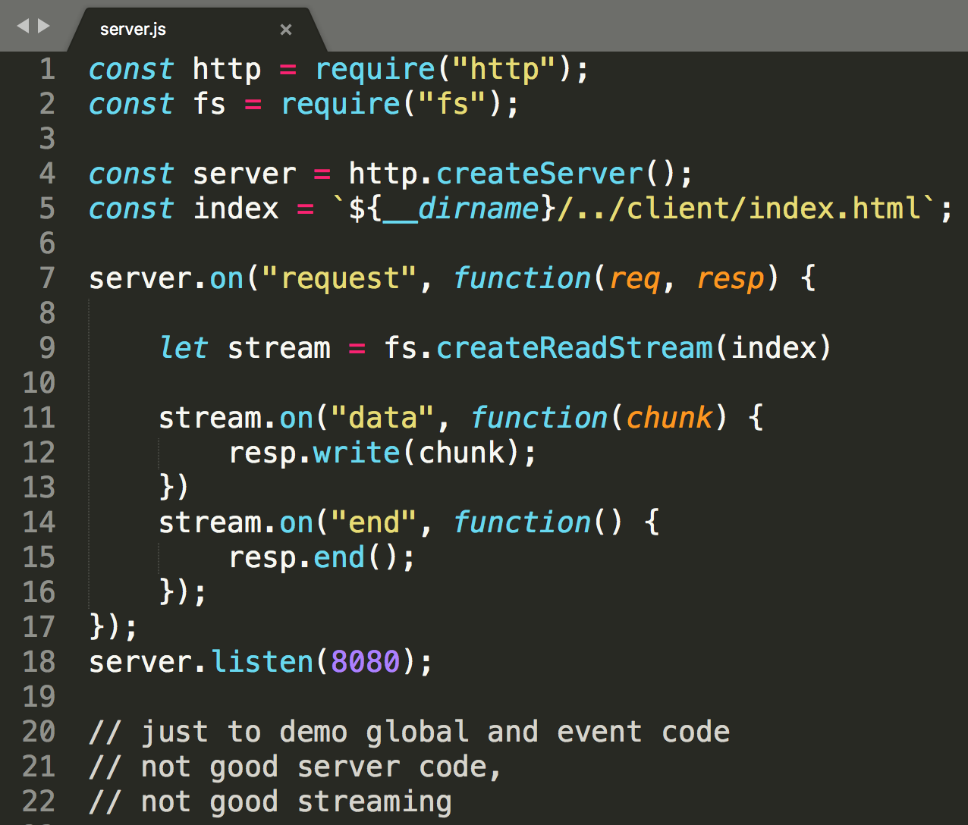
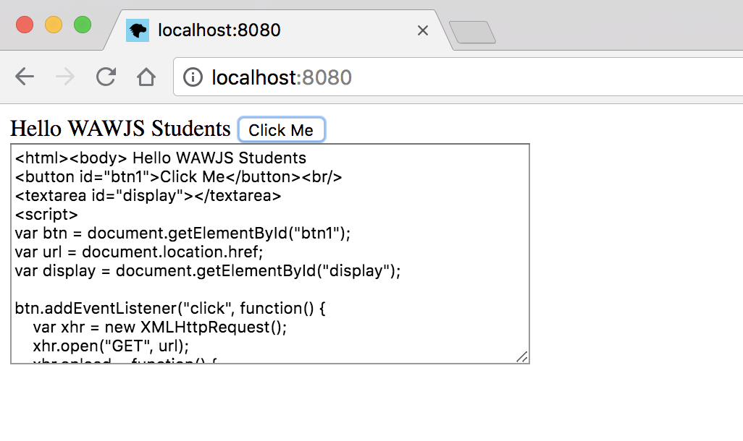
node.js the most popular server side runtime
see 01.02-node.pptx

Slide 32
jjs vs jrunscript ?
There are two command-line tools that can be used to invoke the Nashorn engine:
jrunscript - This is a generic command that invokes any available script engine compliant with JSR 223. By default, without any options, jrunscript invokes the Nashorn engine, because it is the default script engine in the JDK.
jjs - This is the recommended tool, created specifically for Nashorn. To evaluate a script file using Nashorn, pass the name of the script file to the jjs tool. To launch an interactive shell that interprets statements passed in using standard input, start the jjs tool without specifying any script files.
JEP 335: Deprecate the Nashorn JavaScript Engine
https://stackoverflow.com/questions/50958644/threading-in-jrunscript-vs-jjs

Slide 33
Things around JavaScript
there is huge
heterohenous and
historically large set if
"things around javascript"

Slide 34
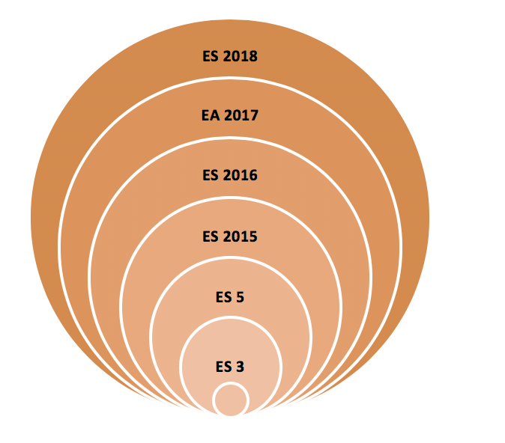

modules, bundlers, transpilers,....
polyfils
traceur
polyfils
babel
<script src="x.js">
closure compiler
x.js
cofeescript
...
<script src="y.js">
uglify-js
y.js
typescript
<script src="app.js">
webpack
AMD
CJS
require("")
browserify
UMD,...
<script type=module src=...
ESM
*.jsm
WebAssembly
...
C++
WebAssembly
bower
gulp
grunt
npm-scripts
npm

Slide 35
... and more

Slide 36

__aux
čo sa nezmestilo do prednášky
bonus materiály a témy
a neutriedené poznámky

